Slide 1

Basic Details of the Team and Problem Statement
Ministry Department of Space, Indian Space Research Organization (ISRO)
PS Code: SS589
Problem Statement Title: Weather Forecast and its Visualization using Augmented Reality (AR): Mobile App
Theme : Disaster Management

Slide 2
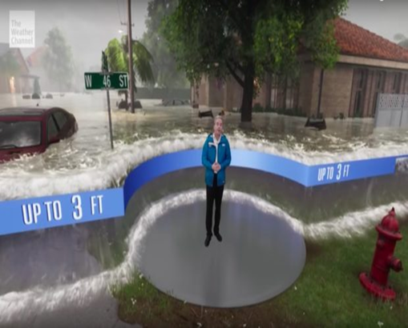
Problem Description
Prediction of level of extent of damage caused by any natural disaster like flood, tsunami, earthquake, etc., and to give awareness to the people to take precautionary steps by providing them an AR implemented model of the impact caused by the disaster .

Slide 3
Idea/Approach Details
Describe your idea/Solution/Prototype here:
Our idea is to build a weather forecasting application using Augmented Reality ,which will provide a virtual generated scene of real time effect of the natural disaster.
By using SLAM algorithm in AR core platform ,it compares visual features between camera frames in order to map and track the environment.
Our app uses DARK SKY API to collect the weather information of the world .It returns a minute by minute forecast for next hour & hour by hour forecast for next 48 hours & day by day forecast for next week.
3D models have built with a help of Sceneform SDK 1.16.0 which is a high level scene graph API .

Slide 4

Describe your Technology stack here:
DARK SKY API
ANDROID STUDIO
AR CORE
SCENEFORM SDK 1.16.0
ADOBE XD

Slide 5

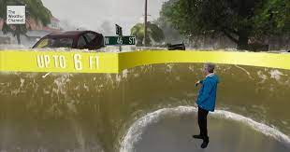
IMPLEMENTATION
DARK SKY API
AR CORE
SCENEFORM 1.16.0
Testing
App Deploy

Slide 6
AR ALGORITHM
AR technology uses SLAM (simultaneous localization and mapping): a computer vision algorithm that compares visual features between camera frames in order to map and track the environment.
In combination with sensor data from the smartphone gyroscope and accelerometer, it is possible to achieve very reliable tracking.

Slide 7
DARK SKY API
It is a robust API that provides comprehensive weather information about any place in the world.
It returns a wide range of details, including the including the current weather conditions, a minute-by-minute forecast for the next hour, an hour-by-hour forecast for the next 48 hours, and a day-by-day forecast for the next week.
ADVANTAGES
It’s an accurate source of hyperlocal weather information. Weather data is frequently updated.
Historical weather data, which goes back to several decades, is available.
It supports 39 different languages.

Slide 8
SCENEFORM SDK
Sceneform allows you import and view 3D models( in such formats as .obj , .fbx or .gTF )
Then render realistic 3D scenes for AR Core apps .
It includes a high level SceneGraph API , a physically based renderer provided by filament and Android Studio plugin for building 3D assets.
AR Core is not able to import and render 3D models, so we use SCENEFORM SDK 1.16.0

Slide 9
RESOLVING THE LIMITING FACTORS
In case of no net connectivity the resolution of the image will be decreased , so we will use WebP images which is a lossless compression image format.
WebP image will be stored in user’s phone cache memory , so that the user an view the high resolution picture even in offline.
When the network is blocked or low , the requests generated by the users are stacked in Queue
When the network is back the app can send all request from the Queue back to the DARK SKY API to fetch the required information.

Slide 10
CONCLUSION
By using our app we are able to predict the extent of damage caused by natural disasters and to evacuate people to a much safer place to avoid damage to human life and property.

Slide 11

Team Member Details
AKMAL FOWMILA A S
BAVITHRA P
SRI NIKETHAN T
SIVAPRAKAS B M
SURYAPRAKASH K
MUTHU SARAVANAN K

